Slide 1
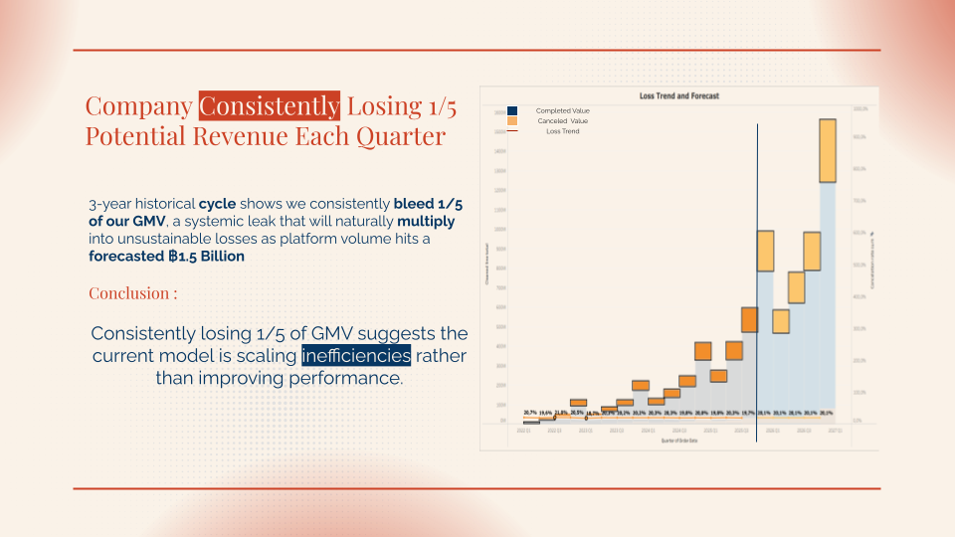
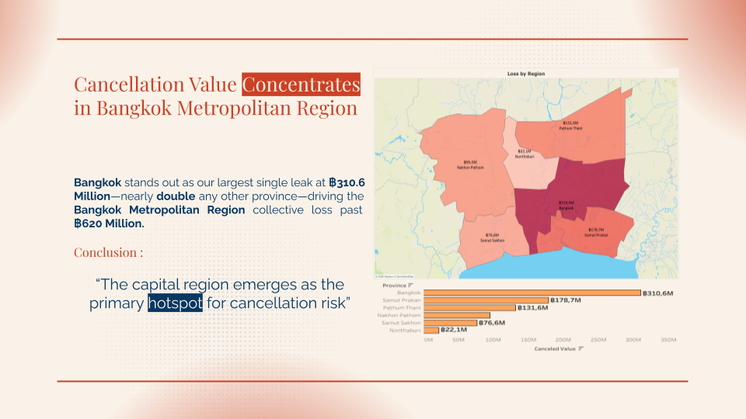
Project Summary
Title : Shopee Thailand Sales Performance
Scope : Cancelation Loss
Skills : Python, Tableau, Business Acumen, Data Preparation, EDA, Correlation, Pareto
Problem
Shopee Thailand experiences 20% Revenue Loss due to Cancelation, with value excess ฿800 Million in the past 3 years
Objective
Analyze Trends and patterns to find the best method to decrease loss due to cancellations to 10% by 2028
Findings
Cancellation value is not evenly distributed—it is heavily concentrated among high-volume transactions, the 20–40 customer segment, and core product categories like Home and Electronics.
Recommendation
Suppressive : High-Density Sales Interventions Preventive : Deploy Value-Based Retaining Triggers
Preservative : Standardize Cancellation Monitoring

Slide 2

Shopee Thailand Sales Performance
Name : Afrizal Anshari Makatita

Slide 3
Table of contents
Executive Summary
Analysis Result
Project Background
Recommendation
Business Problem
Tableau Dashboard
Methodology
Appendix

Slide 4
Executive Summary
Problem
Shopee Thailand experiences 20% Revenue Loss due to Cancelation, with value excess ฿800 Million in the past 3 years
Objective
Analyze Trends and patterns to find the best method to decrease loss due to cancellations to 10% by 2028
Findings
Cancellation value is not evenly distributed—it is heavily concentrated among high-volume transactions, the 20–40 customer segment, and core product categories like Home and Electronics.
Recommendation
Suppressive : High-Density Sales Interventions Preventive : Deploy Value-Based Retaining Triggers
Preservative : Standardize Cancellation Monitoring

Slide 5
Project Background
Contextualizing the Business challenge

Slide 6
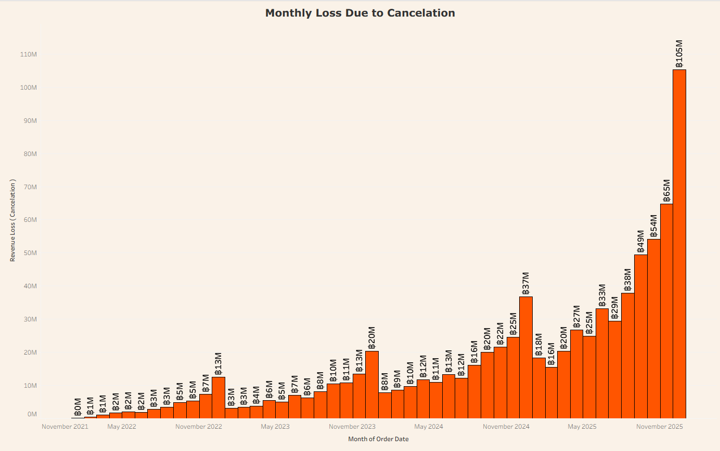
Shopee Strive for Improvement - But do we?
3 Years of Recurring Problem Without Resolution
The Head of Shopee Thailand has tasked the Data Team with delivering solutions to mitigate the persistent high revenue loss driven by canceled orders over the past three years.
The escalation reached a critical point in December 2025, when losses spiked by 35% from previous year to ฿ 105 million. Due to persistent upward trend over the years, the Head of Branch has prioritized the immediate deployment of solutions.

Slide 7
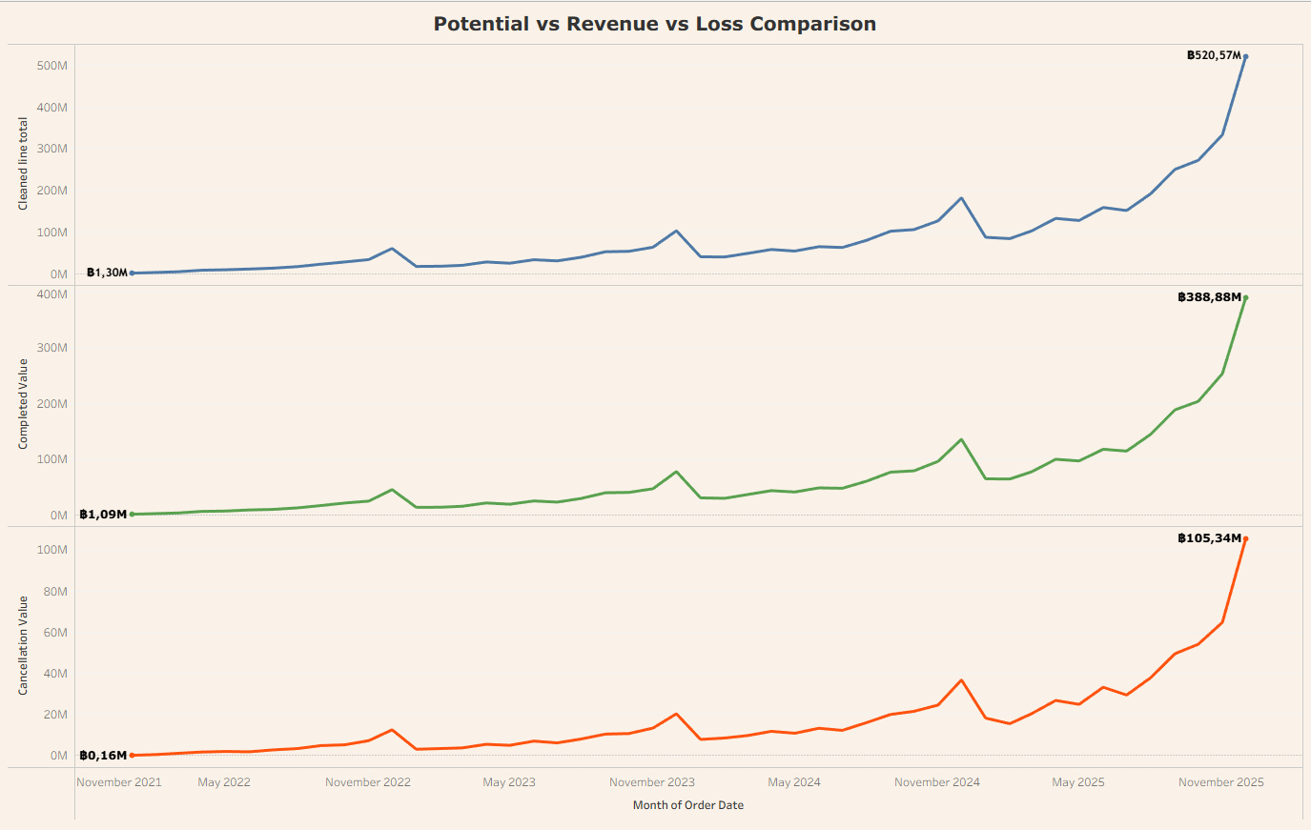
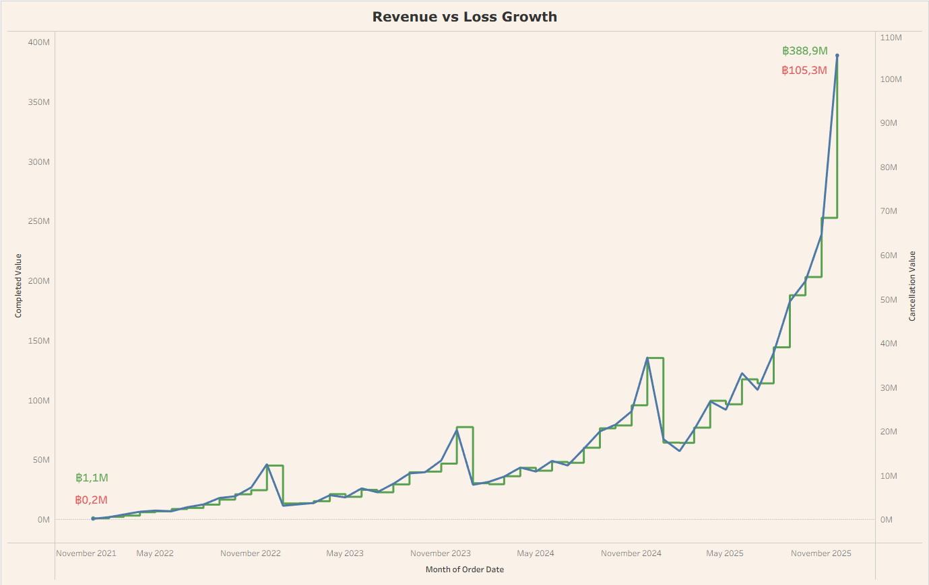
Our Revenue also Increase - Surely it’s not a big deal Right?
Loss Surpass Industry Benchmark , Risky!
While our revenue has increased rapidly over the past three years, this growth does not diminish the urgency of the issue. In fact, our revenue loss tracks almost identically with our revenue growth trend. December 2025 data highlights a critical leakage: we forfeited 105 million Baht out of ฿ 520 million in potential revenue. This translates to a staggering 20% revenue loss strictly driven by order cancellations. Which is past industry benchmark of 16% (Source)
Therefore the scope of analysis will heavily focus on Loss due to Cancelation and find the solution on how we can effectively decrease the value.

Slide 8
“How to decrease revenue loss from order cancelation From 20% to 10% by the end of 2028”
“ To find the right method to decrease revenue loss from order cancelation by 10% in 3 years”

Slide 9
Methodology
Project Workflow

Slide 10
Business Understanding
Data Collection
Data Cleaning
Understanding what is the business demand is and how to solve it
Gathering relevant data from the database with additional data if required
Cleaning data using necessary tools such as Python and Spreadsheet to be analyze ready
Data Communication
Data Visualization
Data Analysis
Transfer insights and recommendation to the audience with proper manner
Interpret and translate the data into visual to enhance acceptability using Tableau
Generate insights from the findings in the data using the tools such as Python, Spreadsheet or Tableau

Slide 11
Analysis Result
Discovering What Matters Most

Slide 12
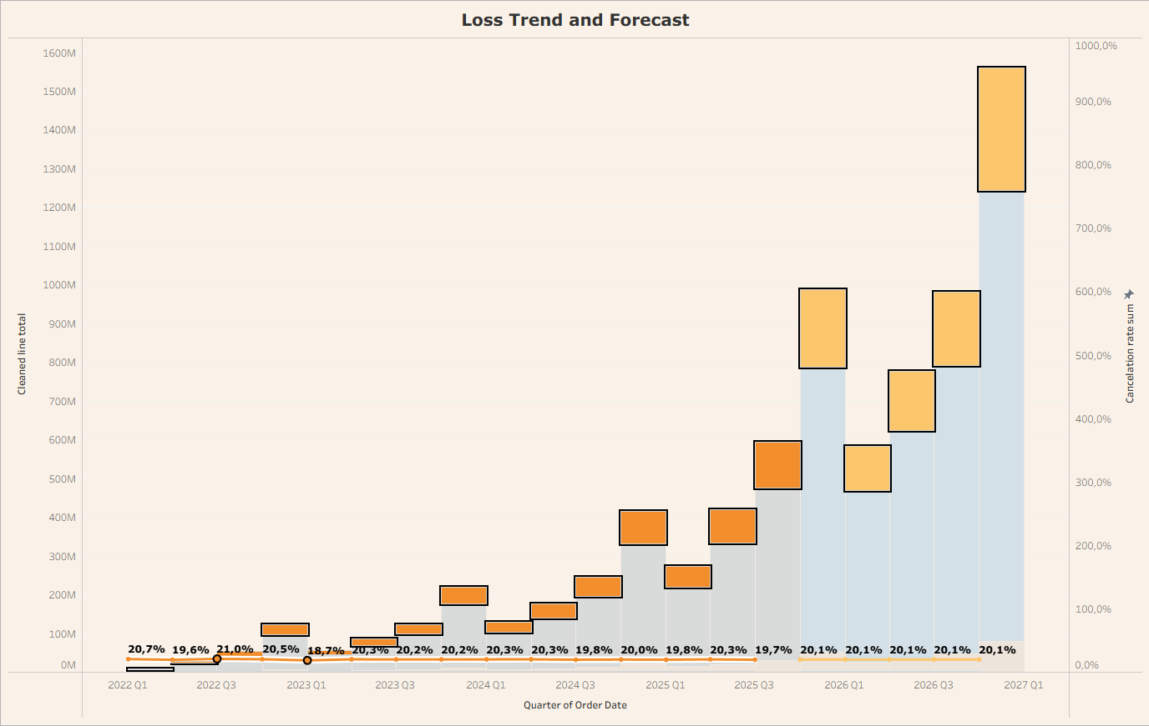
Company Consistently Losing 1/5 Potential Revenue Each Quarter
Completed Value
Canceled Value
Loss Trend
3-year historical cycle shows we consistently bleed 1/5 of our GMV, a systemic leak that will naturally multiply into unsustainable losses as platform volume hits a forecasted ฿1.5 Billion
Conclusion :
Consistently losing 1/5 of GMV suggests the current model is scaling inefficiencies rather than improving performance.

Slide 13
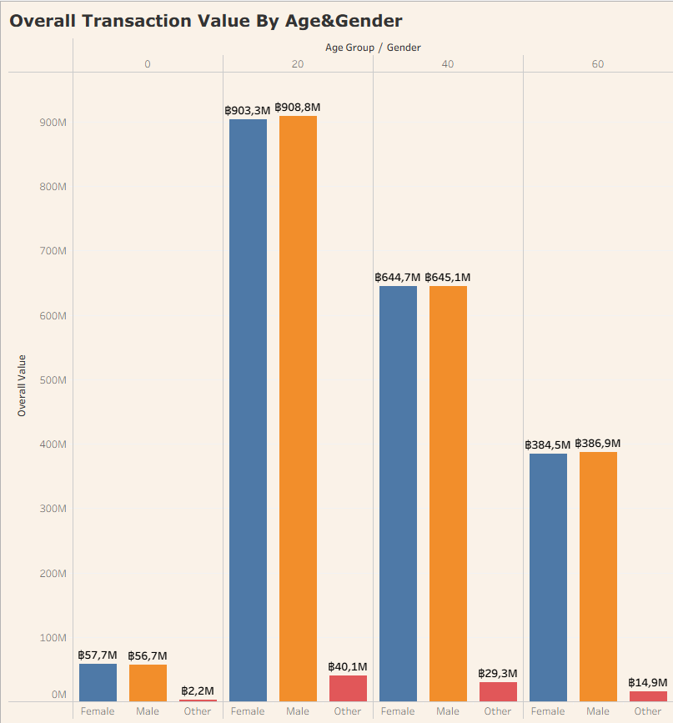
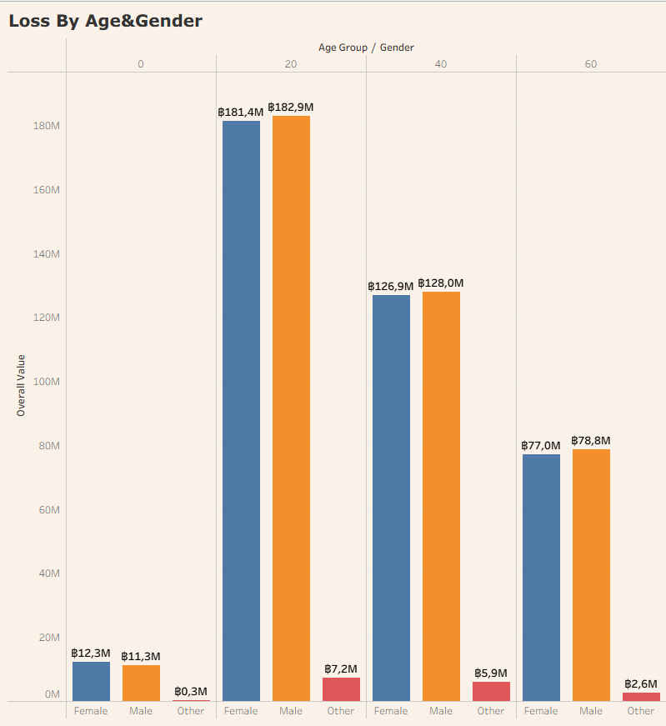
Customers Aged 20–40 Bears the Heaviest Financial Volume
As our primary economic driver, the 20 & 40 demographic generates a massive ฿3.1 Billion in overall GMV, which directly translates into our largest absolute financial leak of over ฿619 Million.
Conclusion :
“The 20–40 age segment acts as our core transaction driver, which correlates to them holding the largest share of loss”

Slide 14
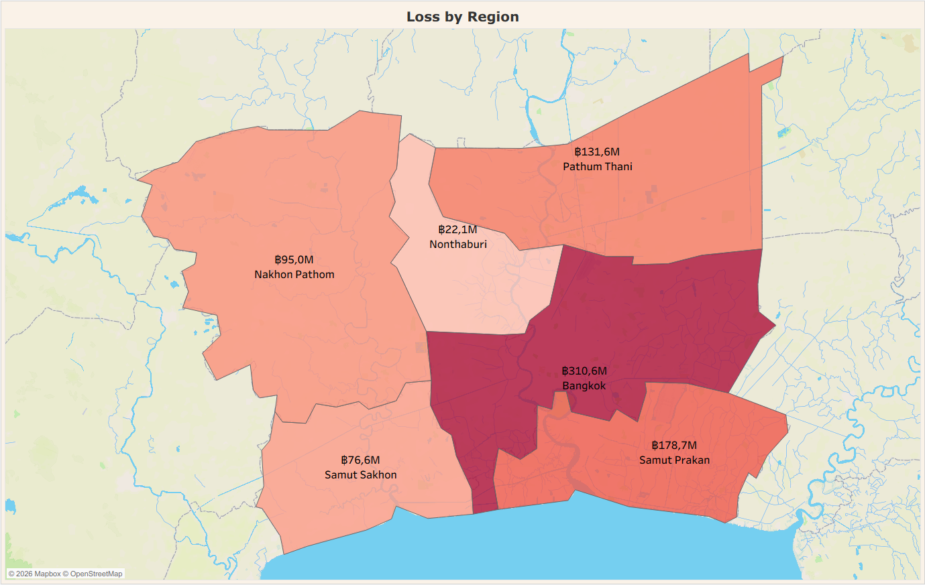
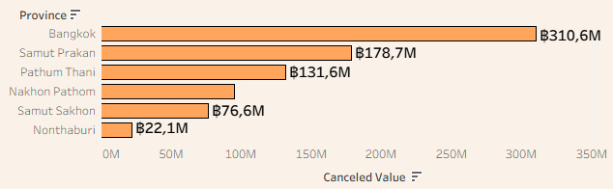
Cancellation Value Concentrates in Bangkok Metropolitan Region
Bangkok stands out as our largest single leak at ฿310.6 Million—nearly double any other province—driving the Bangkok Metropolitan Region collective loss past ฿620 Million.
Conclusion :
“The capital region emerges as the primary hotspot for cancellation risk”

Slide 15
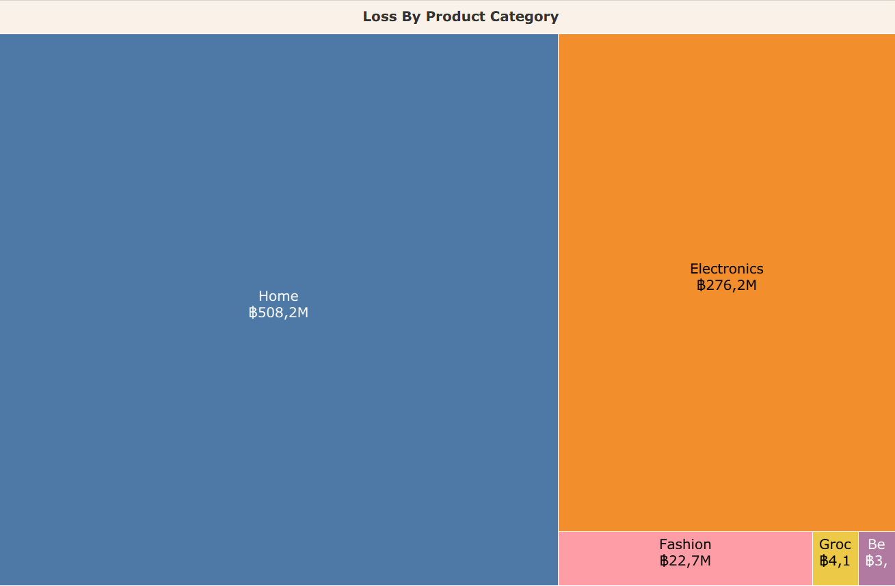
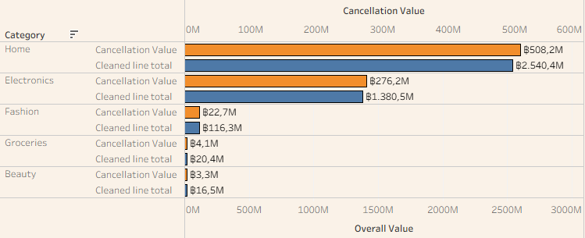
Home and Electronics Anchor 96% of Total Cancelation Value
Led by Home at ฿508.2 Million, both the Home and Electronics categories dictate our financial leakage as their cancellation values scale symmetrically with their massive sales volumes.
Conclusion :
“Cancellations is highly centralized, with Home and Electronics alone capturing nearly the entire wasted Value

Slide 16
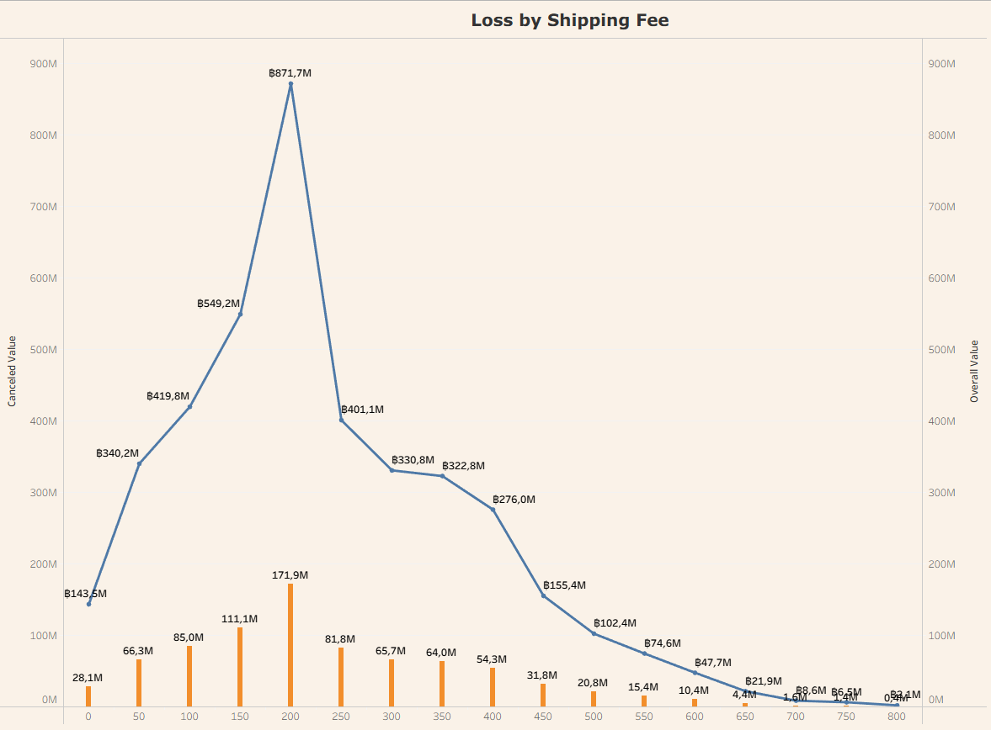

Cancellation Value Centers Symmetrically at ฿200
Cancellation value closely tracks order volume, peaking at ฿170 M within the ฿200 shipping fee tier and remaining stable even above ฿400, suggesting limited sensitivity to delivery costs.”
Conclusion :
"Cancelation Value is baseline-driven, showing zero friction from delivery costs."

Slide 17
What the Data Reveals
Volume Driven
20% Baseline
“Cancellations Value simply track our revenue. The more we sell in a specific segment, the more money we lose there”
“The Cancellation Value is consistent at 20% across the board. It does not shift, no matter how we slice the data”

Slide 18
Recommendation
Systematic Approach to Solutions

Slide 19
Proposed Recommendation
Volume Driven
Focus Interventions Directly on High-Density Sales Segments
Deploy Value-Based Retaining Triggers at Checkout
20% Baseline
Standardize Cancellation Monitoring Across All Dashboards

Slide 20
Recommendation Workflow
Focus Interventions Directly on High-Density Sales Segments
Automatically prioritizes the resources for these segment
Allocate targeted operational buffers during peak traffic
Identify top-tier revenue segments
Flag high-density zones where total transaction volume peaks
Dynamic Allocation
Apply localized promo or partner courier in these high-volume sectors
Goal is to secure the largest pools of revenue from minor friction points.
Segment Identification
Targeted Optimization

Slide 21
Recommendation Workflow
Deploy Value-Based Retaining Triggers at Checkout
High-value carts trigger an immediate retention step instead of direct cancellation.
System displays a dynamic incentive
Apply value-based assessment when cancellation requests are submitted.
Distinguish high-value carts from low-value ones automatically.
Dynamic Friction Trigger
User either accepts the incentive or proceeds with a mandatory feedback reason.
High-value retention data is instantly logged to measure saved GMV
Order Value Screening
Intent Resolution

Slide 22
Recommendation Workflow
Standardize Cancellation Monitoring Across All Dashboards
Launch a shared live dashboard visible to Product, Commercial, and Logistics teams.
Display real-time leakage values alongside baseline thresholds.
Define a single, standardized financial cancellation metric across all internal systems
Sync raw order status data into a centralized data pipeline.
Cross-Department Dashboard
Set up automated alerts if a specific department's segment crosses the 20% baseline.
Teams hold unified reviews to address anomalies before they scale.
Metric Synchronization
Cross-Functional Alignment

Slide 23
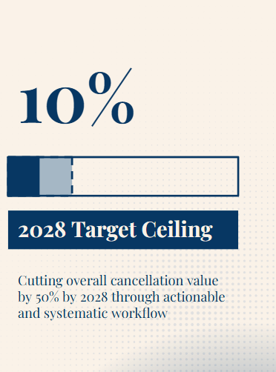
Expected Result
"By shifting our focus from general operational fixes to value-driven, high-density interventions, we can structurally secure our GMV and support progress toward the 10% target
Target Realization
Achieving a 10% cancellation value ceiling by the end of 2028 through high-density interventions.
Reduce cancellation losses through targeted recovery initiatives.
Operational Efficiency
Zero wasted effort by shifting 100% of internal focus and server resources to secure high-density sales channels
Eliminating isolated operational blind spots through targeted partner-courier and merchant guarantees in top-performing regions.
Platform Intelligence
Transitioning to an active system that automatically deploys dynamic retention solutions before money leaves the platform.
Establishing a single source dashboard across demographic and operational variable to prevent department from breaching 10% threshold.

Slide 24
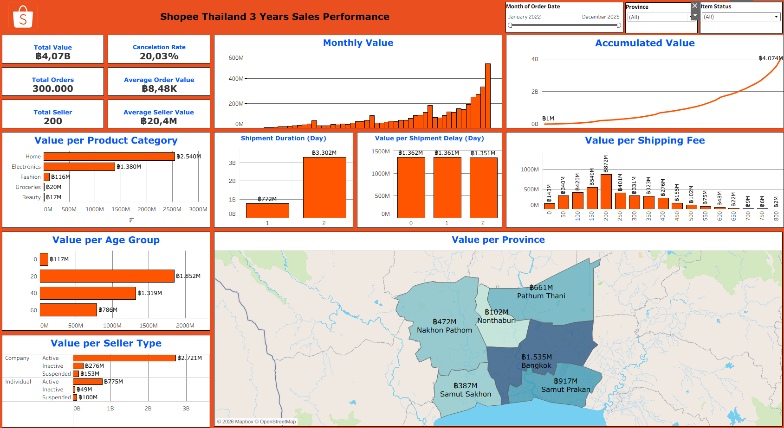
Interactive Dashboard Preview
Tableau Public

Slide 25
Thank You
For your Attention to this presentation

Slide 26
Appendix
Additional Data

Slide 27
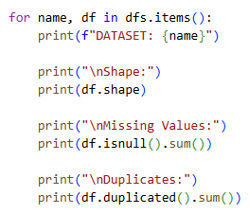
Data Quality Validation
Checking Missing and Duplicate Syntax
Imputing Missing Value
Checking Data Type
Changing Data Type
Example :
Example :
Upload Dictionary
Entity
Column
Syntax to fill null values with 0
Upload Dictionary
Entity
Show data type
Upload Dictionary
Entity
Column
Syntax to change data type (String)
Data is completely unique with 0% duplicate
Data Preparation Workflow
Before
After
Entity | Completeness | Uniqueness | Consistency
Order items | 470134 | 0 | X
Orders | 289653 | 0 | X
Shipments | 0 | 0 | X
Customers | 0 | 0 | X
Sellers | 0 | 0 | X
Products | 0 | 0 | X
Entity | Completeness | Uniqueness | Consistency
Order items | 0 | 0 | O
Orders | 0 | 0 | O
Shipments | 0 | 0 | O
Customers | 0 | 0 | O
Sellers | 0 | 0 | O
Products | 0 | 0 | O
Raw Data
V
Missing Value Check
V
Duplicate Removal
V
Type Standardization
V
Analysis Ready Dataset
Tool ; Python Colab
Completeness : Missing Values Checking
Uniqueness : Duplicate Checking
Consistency : Data Type Checking ( O = Passed X = Not Pass),

Slide 28
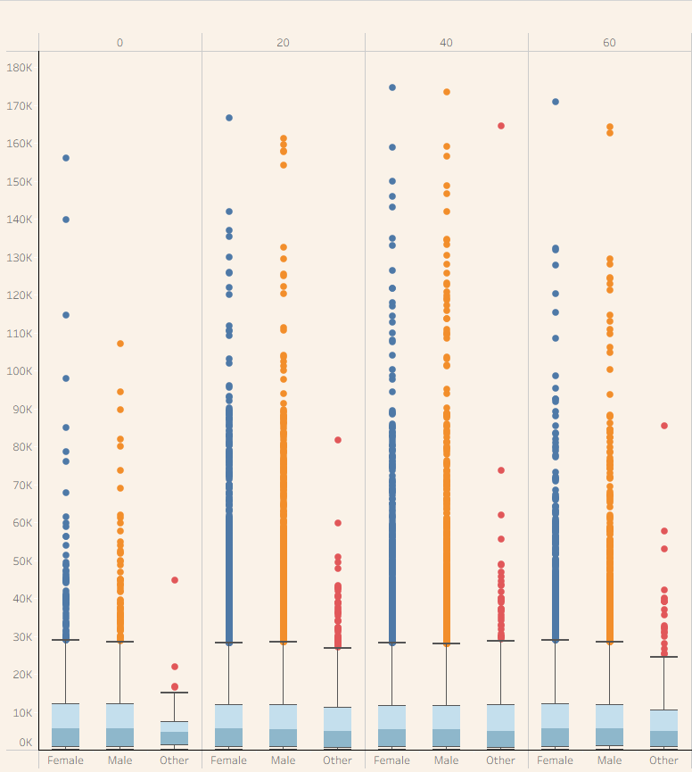
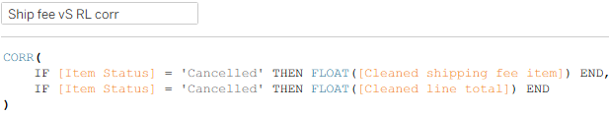

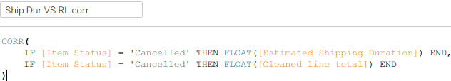

Correlation & Distribution Validation
Demographic Validation
Shipping Fee vs Loss corr
Conclusion: Weak Positive association
Shipping Duration vs Loss corr
Conclusion: Similar median across all demographic
Conclusion: Near Zero, Corelation almost non existent

Slide 29
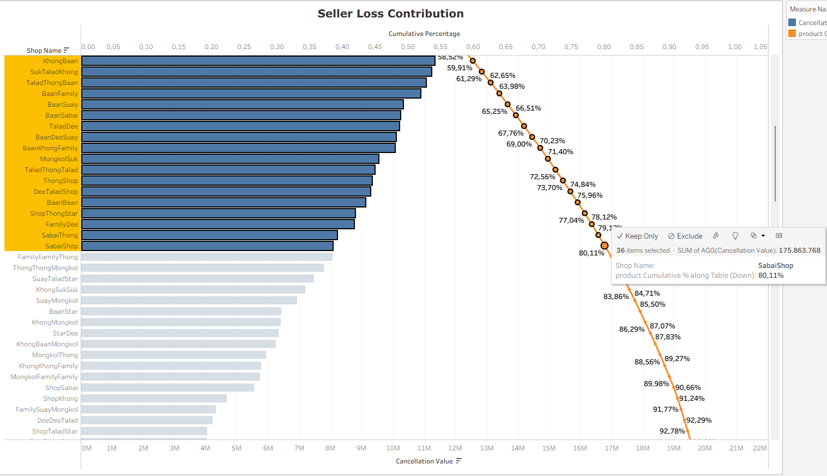
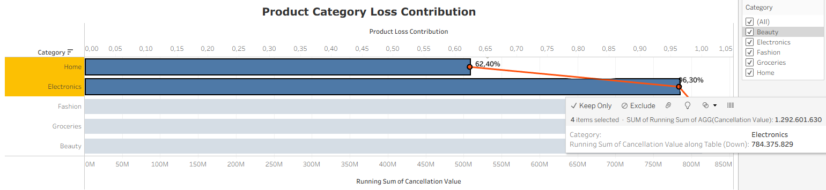
Concentration / Pareto Analysis
Product Category Concentration
Sellers Concentration
Conclusion: Home and electronics contribute 96% of Loss due to Cancelation
Conclusion: 48 out of 200 or roughly 24% sellers contribute 80% of total Loss due to Cancelation

Slide 30
Limitations & Future Work
Limitations
Cancellation reason data was unavailable.
Analysis focuses on historical patterns.
Findings indicate association rather than causation.
Seller operational metrics were not included.
Future Work
Cancellation Reason Analysis
Seller Performance Analysis
Customer Behavior Analysis
Predictive Cancellation Risk Modeling

